Slide 1
Exploratory Data Analysis
Breast Cancer Survival Data Set
By
Prem Ranjan
INSAID GCD, Cohort – Feb 2019
Date: 14- Apr-2019

Slide 2
Introduction
Exploratory Data Analysis (EDA)
Process of asking a series of questions on a given dataset.
Applying statistics and visualization techniques to answer those questions
Uncover the hidden insights from the data.
Finding patterns in Data
Determining relationships in Data
Checking assumptions or hypothesis, based on the available data.
Preliminary selection of appropriate models for machine learning.
Breast Cancer Survival Dataset EDA
As part of this exercise, we will try to accomplish the following tasks,
Analyze the data provided as part of the Breast Cancer Survival Dataset.
Explore the basic use of Pandas and cover the basic commands of EDA.
Perform various data operations e.g. cleaning, munging, combining, reshaping, slicing, dicing, and transforming data for analysis purpose.
Perform Exploratory Data Analysis to predict whether a patient undergoing surgery for breast cancer, survives for more than 5 years or not, based on the age, year of operation & the number of positive axillary nodes detected.

Slide 3
Understanding the Data
Breast Cancer Survival Dataset contains cases from a study that was conducted between 1958 and 1970 at the University of Chicago's Billings Hospital on the survival of patients who had undergone surgery for breast cancer.
The dataset consists of the information about cancer patient and their survival status after operation based on their age at the time of operation & count of positive axillary node found in the patient.
The dataset comprises of 306 observations of 4 columns. Below is a table showing names of all the columns and their description.
Attribute Information:
Sl No | Attribute / Column | Description | Comments
1 | Age | Age of the patient at the time of operation
2 | Years_of_operation | Patient's year of operation
3 | Pos_axillary_nodes | Number of Positive Axillary Nodes detected
4 | Status | Survival Status of the patient post operation | 1 = the patient survived 5 years or longer 2 = the patient died within 5 year

Slide 4
Problem Statement
Perform Exploratory Data Analysis to predict whether a patient undergoing surgery for breast cancer survives for more than 5 years or not, based on the age, year of operation and the number of positive axillary nodes detected.
As part of the exercise, we will understand & analyze the data through the application of,
Visual interpretation of each column in the data.
Spread of the data using distribution plot.
Granular level analysis of each column.
We will also try to answer the following questions,
What is the relationship between Age, Year of Operation & Count of Positive Nodes detected in the patient with the Survival Status?
What is the distribution of Age Groups in the Sample Population?
What is the count of operations in a given range of year?
What is the distribution of patient by N Rating or Count of Positive Axillary Node detected?
What is the co-relation between all the features?
Hypothesis: Patients who had less positive nodes detected and got operated at a lower age has high likelihood to survive longer.

Slide 5
Initial Observations
Dataset comprises of 306 observations of 4 columns. There are no missing values in this data set. Sample population size is small. All the column are of data type integer.
Age of the patients vary from 30 to 83 with 49 unique values. The median age is 52 years. Given the high number of unique values in the dataset, a new categorical variable “Age_Group” was added to group the patients into “Young”, “Adult” and “Senior Citizen”.
12 unique values for the “Year Of Operation” in the dataset with 1958 being the earliest and 1969 the latest.
31 unique values for the “Count Of Positive Axillary Node Detected” with 0 being the least and 52 being the most. Given the high number of unique values in the dataset, a new categorical variable “TNM_Rating_N_Stage” was added to group the patients into various N-Ratings e.g. N0, N1, N2 & N3.
Value of 1 & 2 for the “Status” column was not very intuitive. So, the column was renamed to “Survival Status” and a new categorical column “Years_Survived_After_Operation” was added with values “5 years or longer” for “Status = 1” and “Less than 5 years” for “Status = 2”.
These preprocessing activities will help us understand the data better.
Data Profiling of the dataset would also provide a solid understanding of your data.

Slide 6
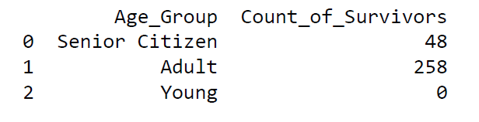
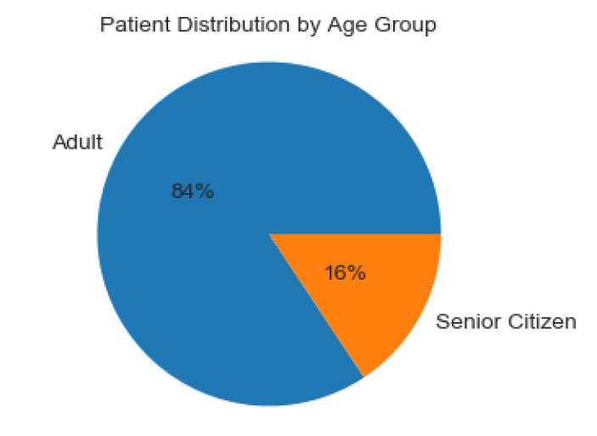
How was the overall survival and the spread of various age groups in the given population?
5 years or longer 225
Less than 5 years 81
Observations
Out of the total population size of 306, 225 patients survived 5 years or longer, while 81 died within 5 years after the year of operation.
The patients were categorized into Young (<25 years), Adult (25 – 64 years) and Senior Citizens (> 64 years).
The sample population had 258 Adults and 48 Senior Citizens.
As the pie-chart “Patient Distribution by Age Group” shows, the Adults made 84% of the patients and the Seniors made 16% of the dataset. There were no Young patients.

Slide 7
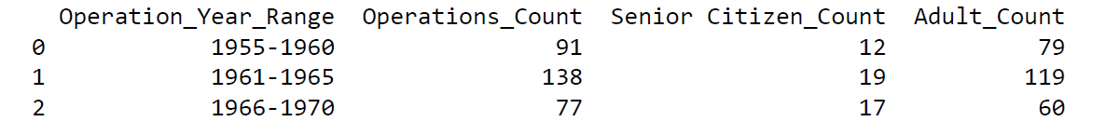
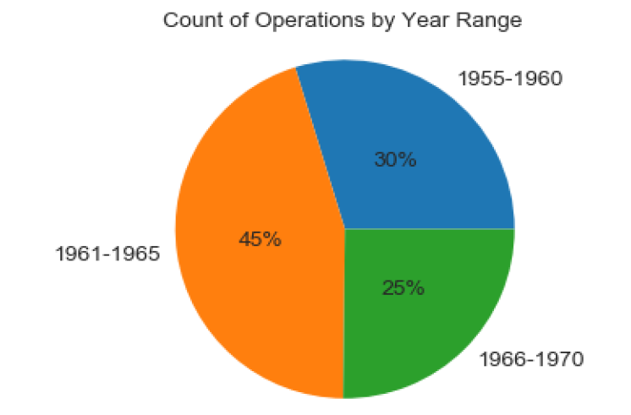
How were the Operations spread across the timeline of the sample dataset?
Observations
The operations were categorized “Operation_Year_Range” based on the Year in which it was done.
Most of the operations “138” or “45%” happened between 1961 - 1965. Out of 138 operations, we had 119 Adults and 19 Senior Citizens.
The next year range was “1955 – 1960” where we had “91” or “30%” of the operations. Out of 91 operations, we had 79 Adults and 12 Senior Citizens.
The last year range was “1966 – 1970” where we had “77” or “25%” of the operations. Out of 77 operations, we had 60 Adults and 17 Senior Citizens.
There was an unusual spike in the number of operations between years 1961 – 1965. But, we do not have enough data to draw any insights.

Slide 8
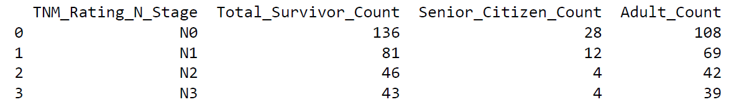
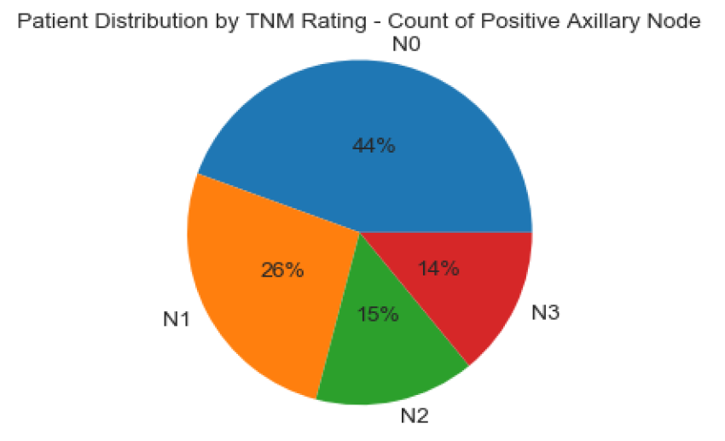
How was the spread of the Positive Axillary Nodes in the given population?
Observations
The patients were categorized into “TNM_Rating_N_Stage” based on the count of Positive Axillary Nodes detected in the patient.
A total of 136 patients were in N0 rating (0 or less than 1 Positive node detected) in the given sample. This is 44% of the sample population.
A total of 81 patients were in N1 rating (less than 3 Positive node detected) in the given sample. This is 26% of the sample population.
A total of 46 patients were in N2 rating (less than 10 Positive node detected) in the given sample. This is 15% of the sample population.
A total of 43 patients were in N4 rating (more than 9 Positive node detected) in the given sample. This is 14% of the sample population.

Slide 9
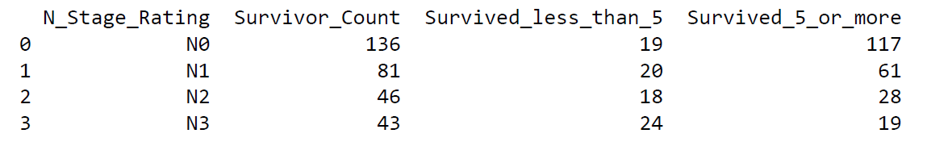
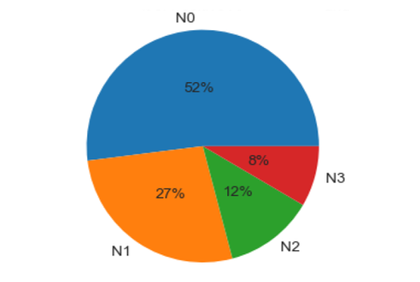

What percentage of the sample population survived 5 years or longer from the Year of Operation with respect to the spread of the Positive Axillary Nodes?
Observations
Out of 136 patients in N0 rating (less than 1 Positive node detected) in the given sample, 117 survived 5 years or longer, which is 52% of the sample size.
Out of 81 patients in N1 rating (less than 3 Positive node detected) in the given sample, 61 survived 5 years or longer, which is 27% of the sample size.
A total of 46 patients were in N2 rating (less than 10 Positive node detected) in the given sample, 28 survived 5 years or longer, which is 12% of the sample size.
A total of 43 patients were in N4 rating (more than 9 Positive node detected) in the given sample, only 19 survived 5 years or longer, which is 8% of the sample size.
Looking at the N Rating and Survival status, it can be inferred that the likelihood of survival beyond 5 years after operation increases with lower N Rating or less count of Positive Nodes detected in a patient.

Slide 10
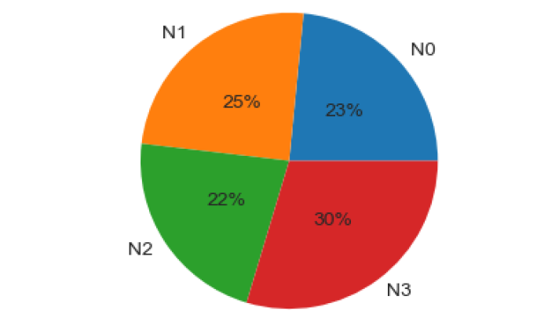

What percentage of the sample population survived less than 5 years from Year of Operation with respect to the spread of the Positive Axillary Nodes?
Observations
Out of 136 patients in N0 rating (less than 1 Positive node detected) in the given sample, 19 survived less than 5 years, which is 23% of the sample size.
Out of 81 patients were in N1 rating (less than 3 Positive node detected) in the given sample, 20 survived less than 5 years, which is 25% of the sample size.
A total of 46 patients were in N2 rating (less than 10 Positive node detected) in the given sample, 18 survived less than 5 years, which is 22% of the sample size.
A total of 43 patients were in N4 rating (more than 9 Positive node detected) in the given sample, 24 survived less than 5 Years, which is 30% of the sample size.
Looking at the N Rating and Survival status, it can be inferred that, as the count of Positive Nodes detected in a patient increases, the percentage population which dies before 5 years from the Year of operation increases.

Slide 11
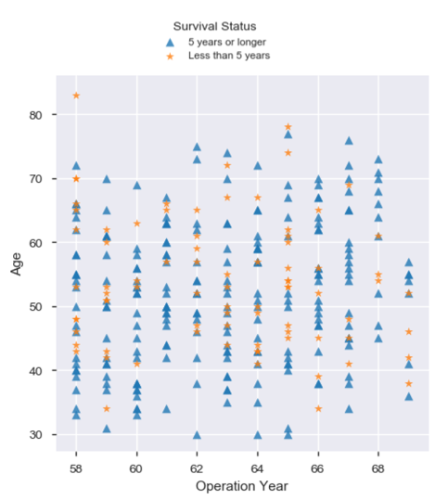
How does Age of the patient & Year of Operation co-relates with the Survival Status
Observations
Most of the patients where in the Age range 40 - 65 years at the time of operation.
Higher percentage of the patients in the Age range 30 - 40 years at the time of operation, survived 5 years or longer.
Only patient above 80 years of age at the time of operation, died within 5 years of the operation.
Most of the patients are in the age range 30 - 65 years i.e Adults.

Slide 12
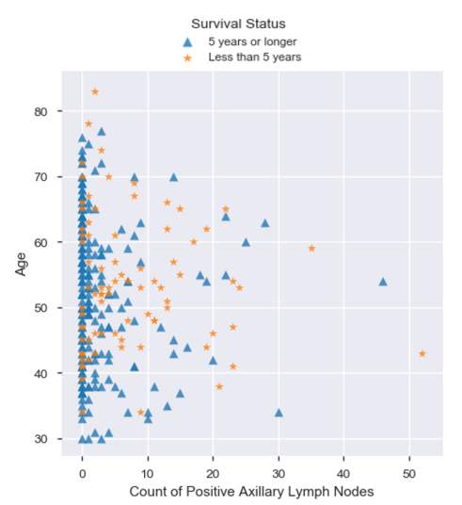
How does Age & Count of Positive Axillary Nodes detected in the patient co-relates with the Survival Status
Observations
Most of the patients had 0 Positive Axillary Node detected and they survived 5 years or longer after the operation.
Higher percentage of the patients with 4 or more Positive Axillary Node detected, survived less than 5 years after operation.
Only patient with more than 50 Positive Axillary Node detected, died within 5 years of the operation.
Most of the patients in the age range 30 - 65 years i.e Adults had less than 10 Positive Axillary Node detected.

Slide 13
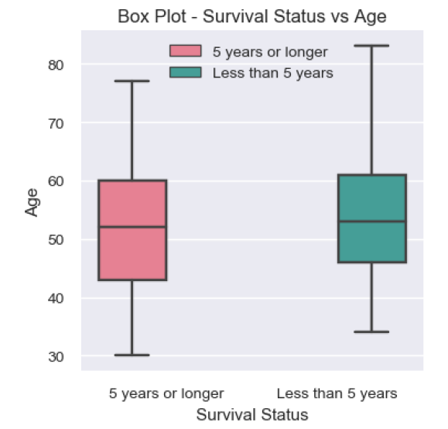
How does the Age of the patient co-relates with the Survival Status?
Observations
Patients with age 30 to 79 at the time of operation, survived 5 years or longer with most between 43-60 years.
Patients with age 32 to 83 at the time of operation, survived less than 5 years with most between 46-61 years.
A large percentage of patients survived less than 5 years after operation fall between 61 – 83 years.

Slide 14
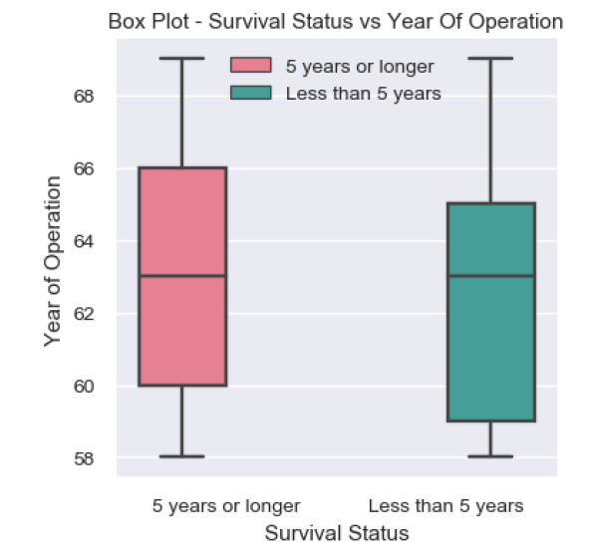
How does Year of Operation of the patient co-relates with the Survival Status?
Observations
We had both cases wherein, the patients who got operated in the year 1958 survived less than 5 years and 5 years or longer
We had both cases wherein, the patients who got operated in the year 1969 survived less than 5 years and 5 years or longer.
The mean Year of operation for patients for both cases lies around 1963.
Most of the operations for patients who survived 5 years or longer was between 1960 - 1966.
Most of the operations for patients who survived less than 5 years between 1959 - 1963.
Based on this data, we don’t see any direct co-relation between Year of operation and length of survival after operation.

Slide 15
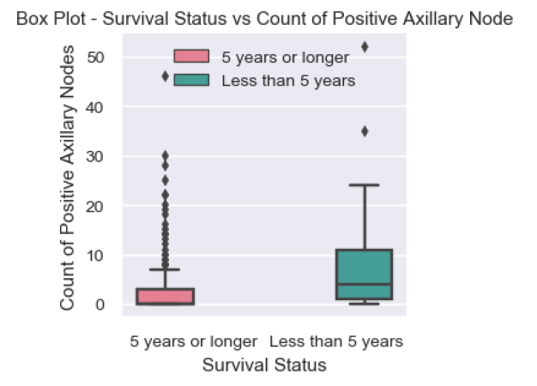
How does the Count of Positive Axillary Nodes detected in the patient co-relates with the Survival Status?
Observations
Most of the patients who survived 5 years or longer had 0 Positive Axillary Node detected.
Most of the patients who survived 5 years or longer had less than 10 Positive Axillary Node detected. This clearly shows a co-relation between length of survival of a patient and count of Positive Axillary Node detected in the patient.
Most of the patients who survived less than 5 years had more than 9 Positive Axillary Node detected. This clearly shows a co-relation between length of survival of a patient and count of Positive Axillary Node detected in the patient.

Slide 16
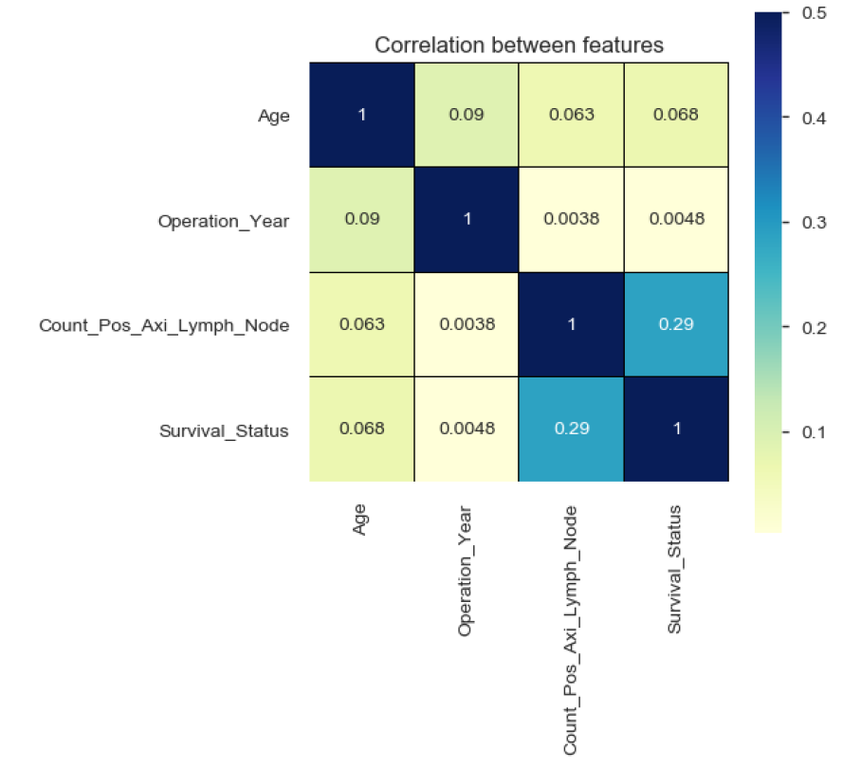
What is the co-relation between all the features?
Observations
Survival Status has a good positive co-relation with the Count of Positive Axillary Node detected in the patient.
Age at the time of operation has a slightly lower but similar co-relation between Count of Positive Axillary Node detected in the patient and the Survival Status.

Slide 17
Conclusion
The observations from the prior slides clearly shows the co-relation between the count of the Positive Axillary Nodes detected in the patient & the age of the patient at the time of operation to their length of survival post operation.
The most important inference drawn from all this analysis is, we can determine the features on which survival is positively or negatively correlated with e.g. relationship between Survival Status with the Count of Positive Axillary Nodes detected in the patient and the Age of the patient at the time of operation.
With the help of this notebook we learnt how exploratory data analysis can be carried out using Pandas plotting.
Also we have seen making use of packages like matplotlib and seaborn to develop better insights about the data.
We have also seen how preprocessing helps in dealing with irregularities present in the data. We also learnt how to create new features which will in turn help us to better predict the survival.
We also make use of pandas profiling feature to generate an html report containing all the information of the various features present in the dataset.
This analysis will help us to choose which machine learning model we can apply to predict survival of test dataset.

Slide 18
Thank You

